Slide 1
المحاضرة السابعة

Slide 2
What is Fourier Series?
Representation of a periodic function with a weighted, infinite sum of sinusoids.
Why Fourier Series?
Any arbitrary periodic signal, can be approximated by using some of the computed weights
These weights are generally easier to manipulate and analyze than the original signal
What is a periodic Function?
A function which remains unchanged when time-shifted by one period
f(t) = f(t + T) or f(t) = f(t + 2p) Where T is the period of periodic function (T = 2p)

Slide 3
f 
0
θ
T
f(θ )
0
θ
T

Slide 4
f 
0
θ
T

Slide 5
Fourier Series
If f (t ) is a periodic function with period
2 p
The function can be represented by a trigonometric series as:

Slide 6
We want to determine the coefficients,
a_{n}
b_{n}
and
.
Let us first remember some useful integrations.
∫
π
cos n θcos m θd θ = 0
n ≠m
−π
∫
π
cos nθcos mθ
dθ = π
n = m
−π

Slide 7
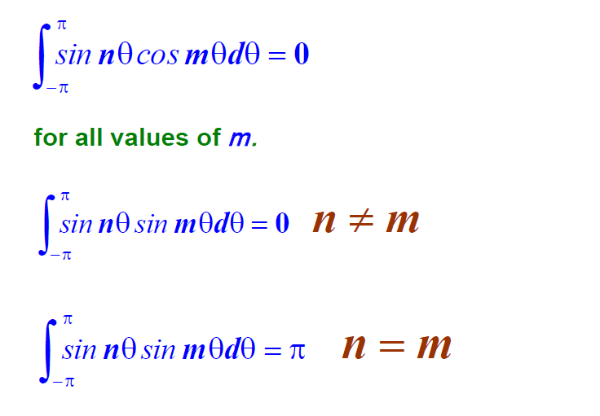

Slide 11
Determine b_{n}
nπt
Multiply Eq.(1) by
sin
p
and then Integrate both sides from d to d+2p
nπt p
∫
d +2 p
f (t )sin
dt
d
= ∫
d +2 p ⎡ a
∞
nπt
∞
nπt ⎤ nπt
⎢ 0
∑a_{n} cos
∑b_{n} sin
⎥sin dt
d
⎣ 2
p
p ⎦ p
n=1
n=1
∫
f (t )sin ^{nπt} dt
d +2 p
b = ¹
n
p
p
d

